Slide 1
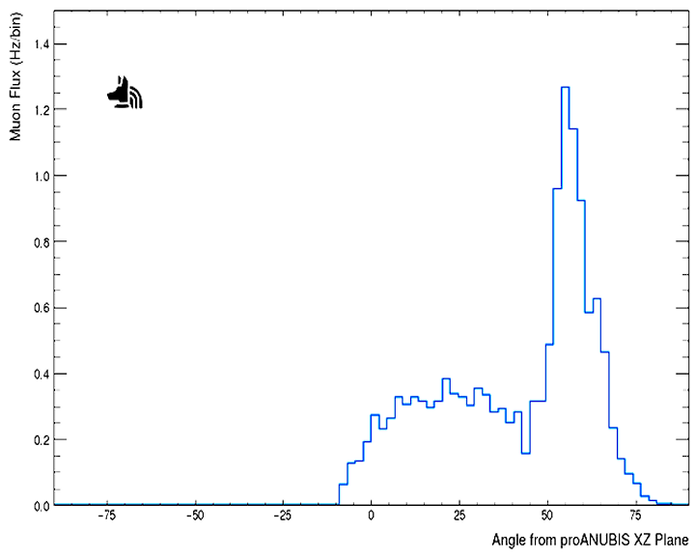
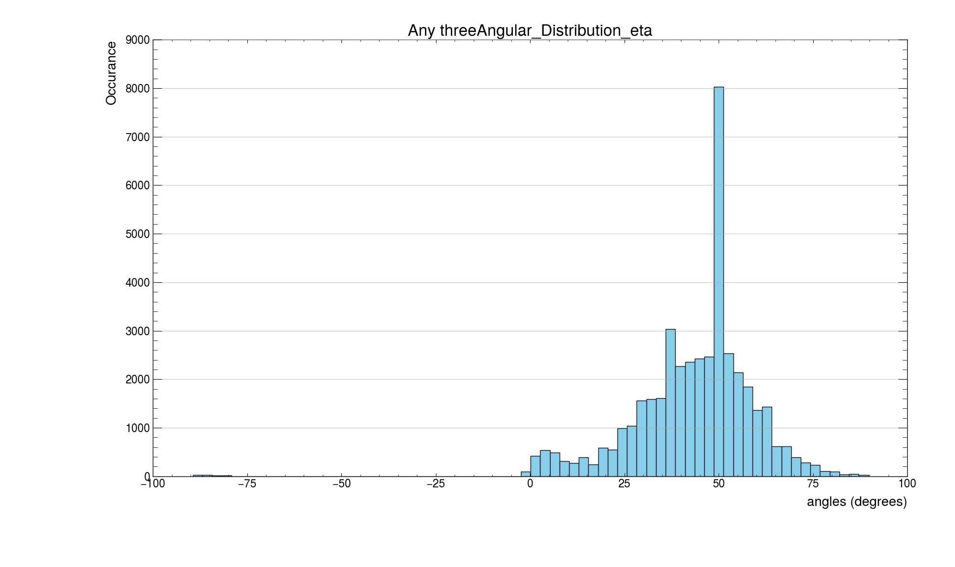

Slide 2
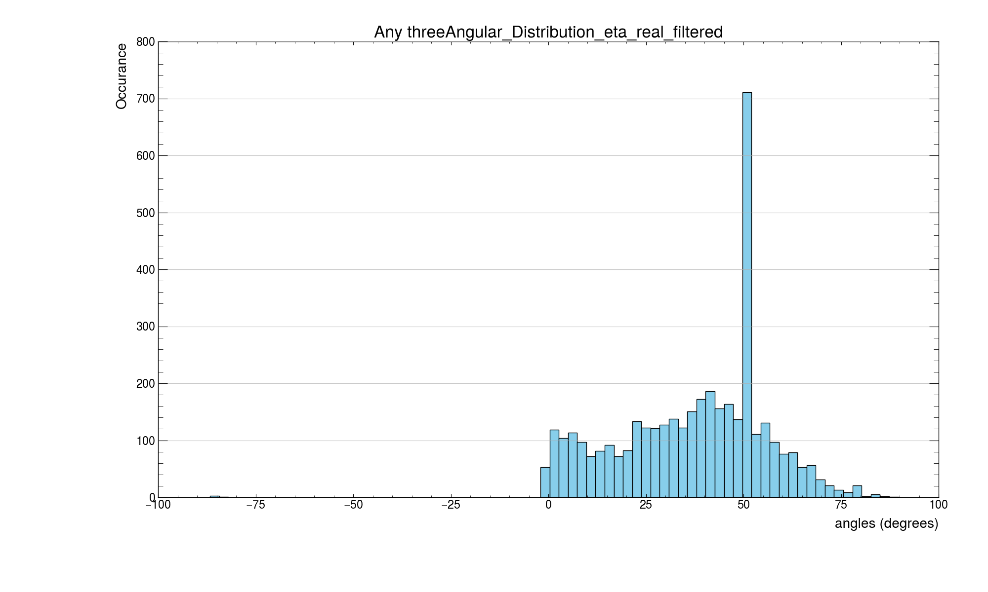

Slide 3
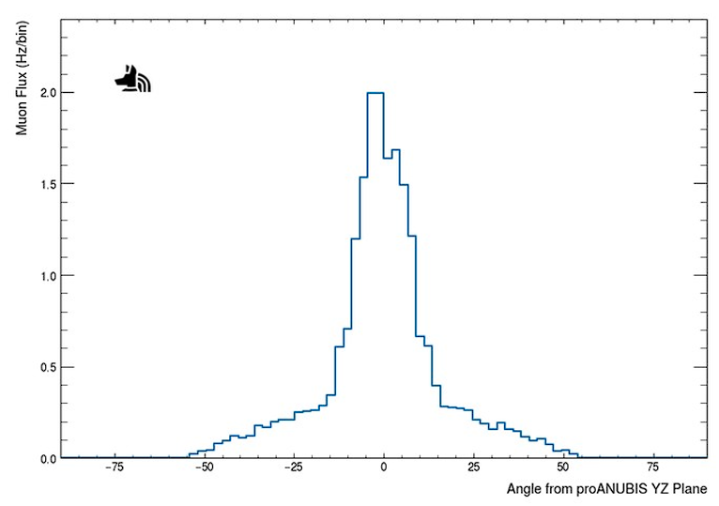
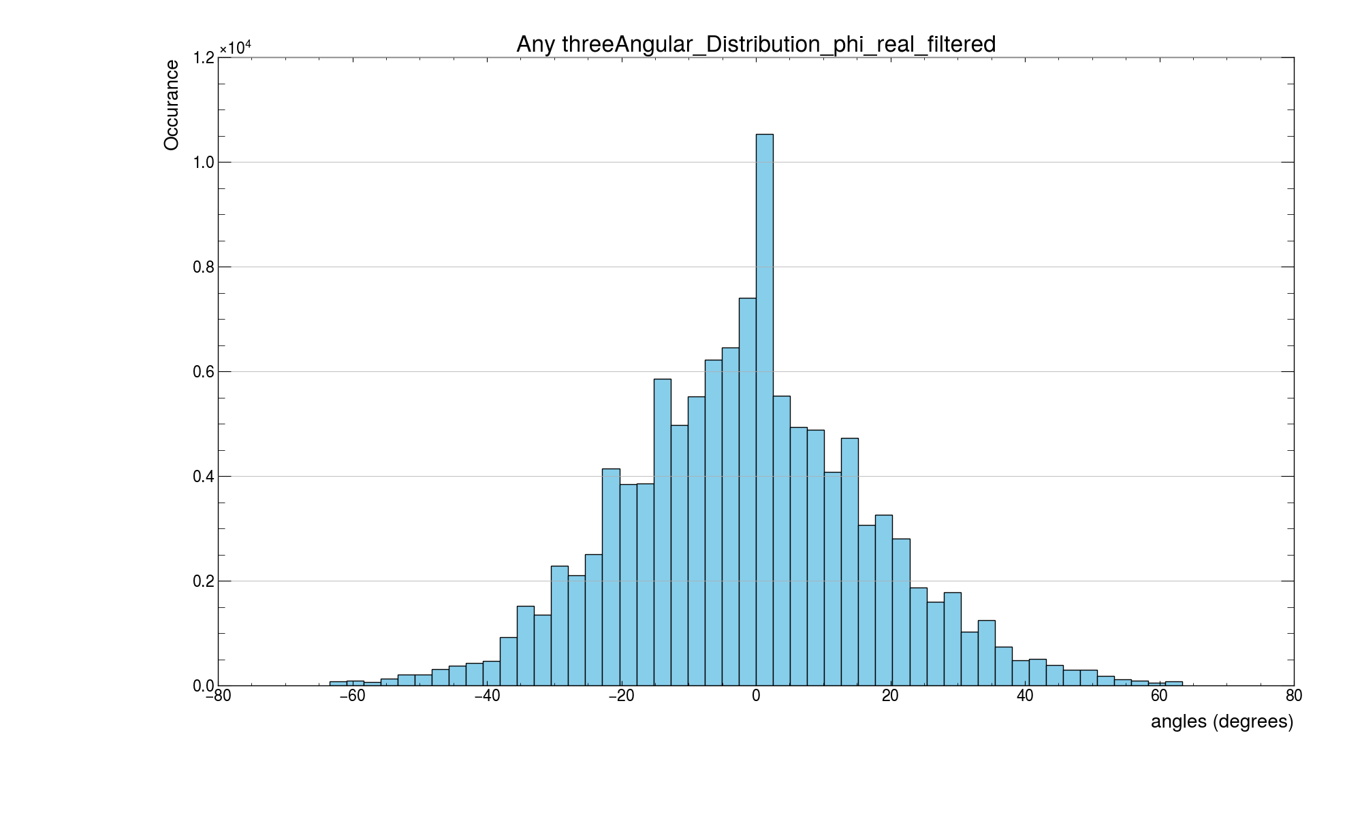

Slide 4
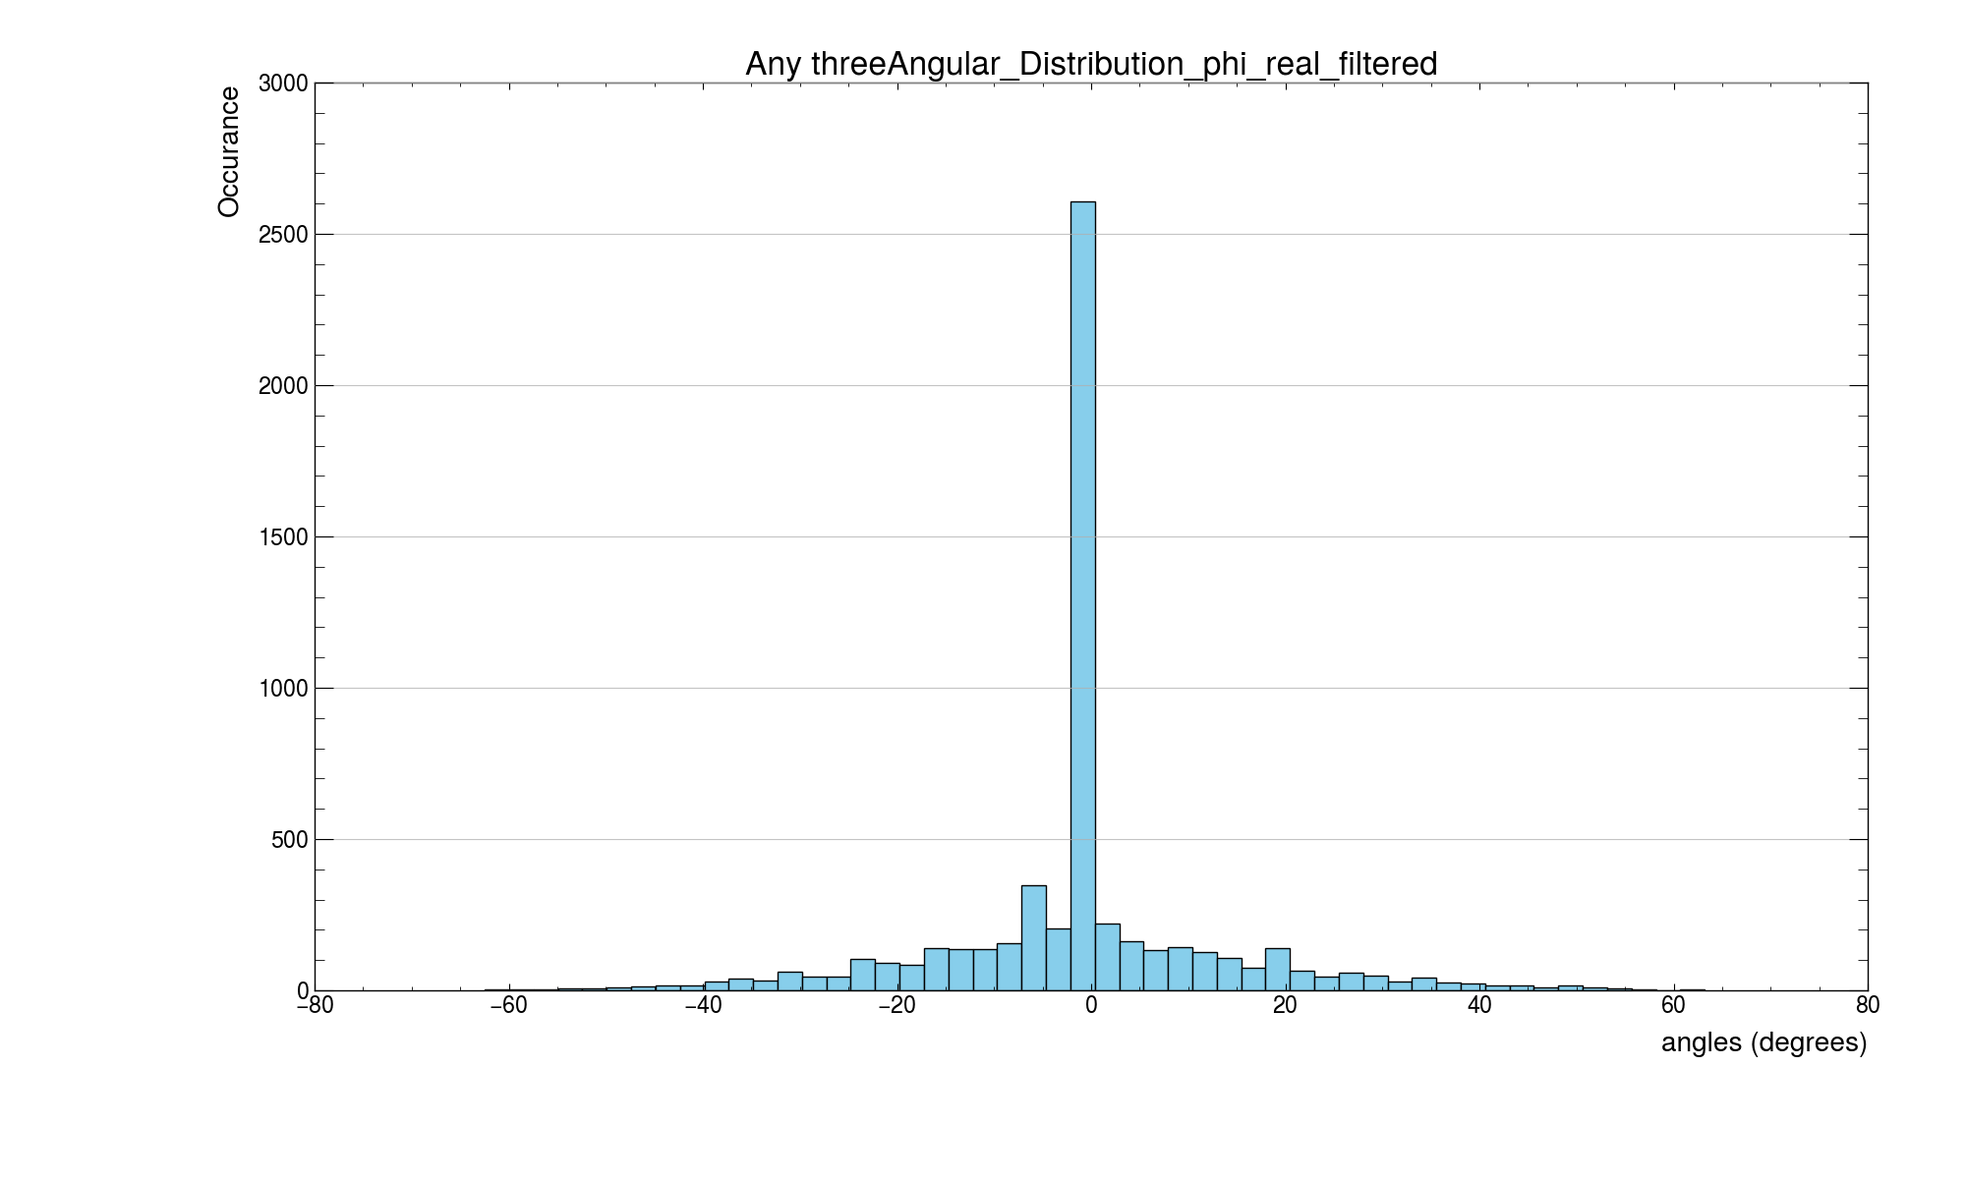

Slide 5
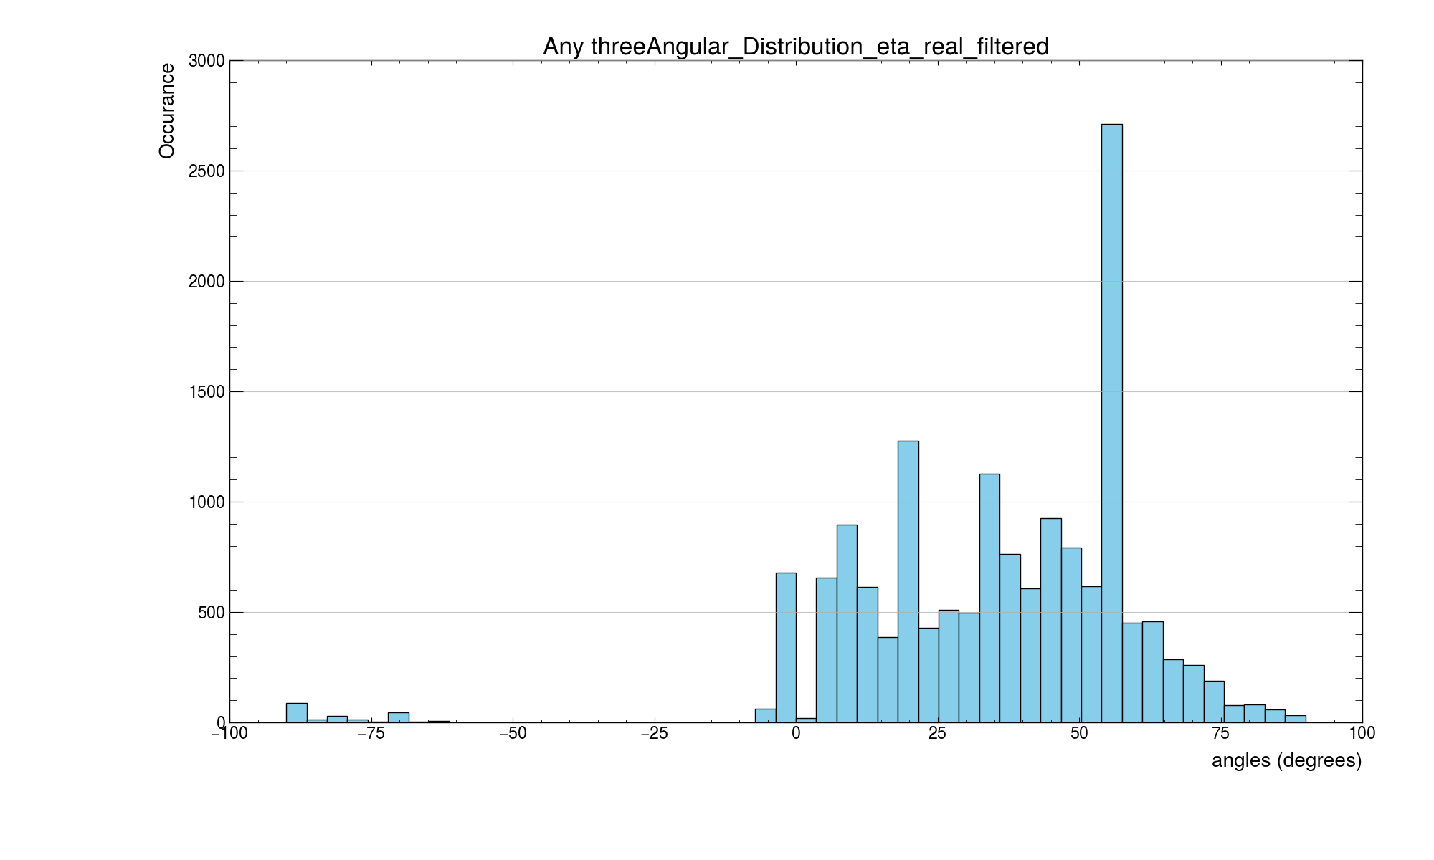

Slide 6
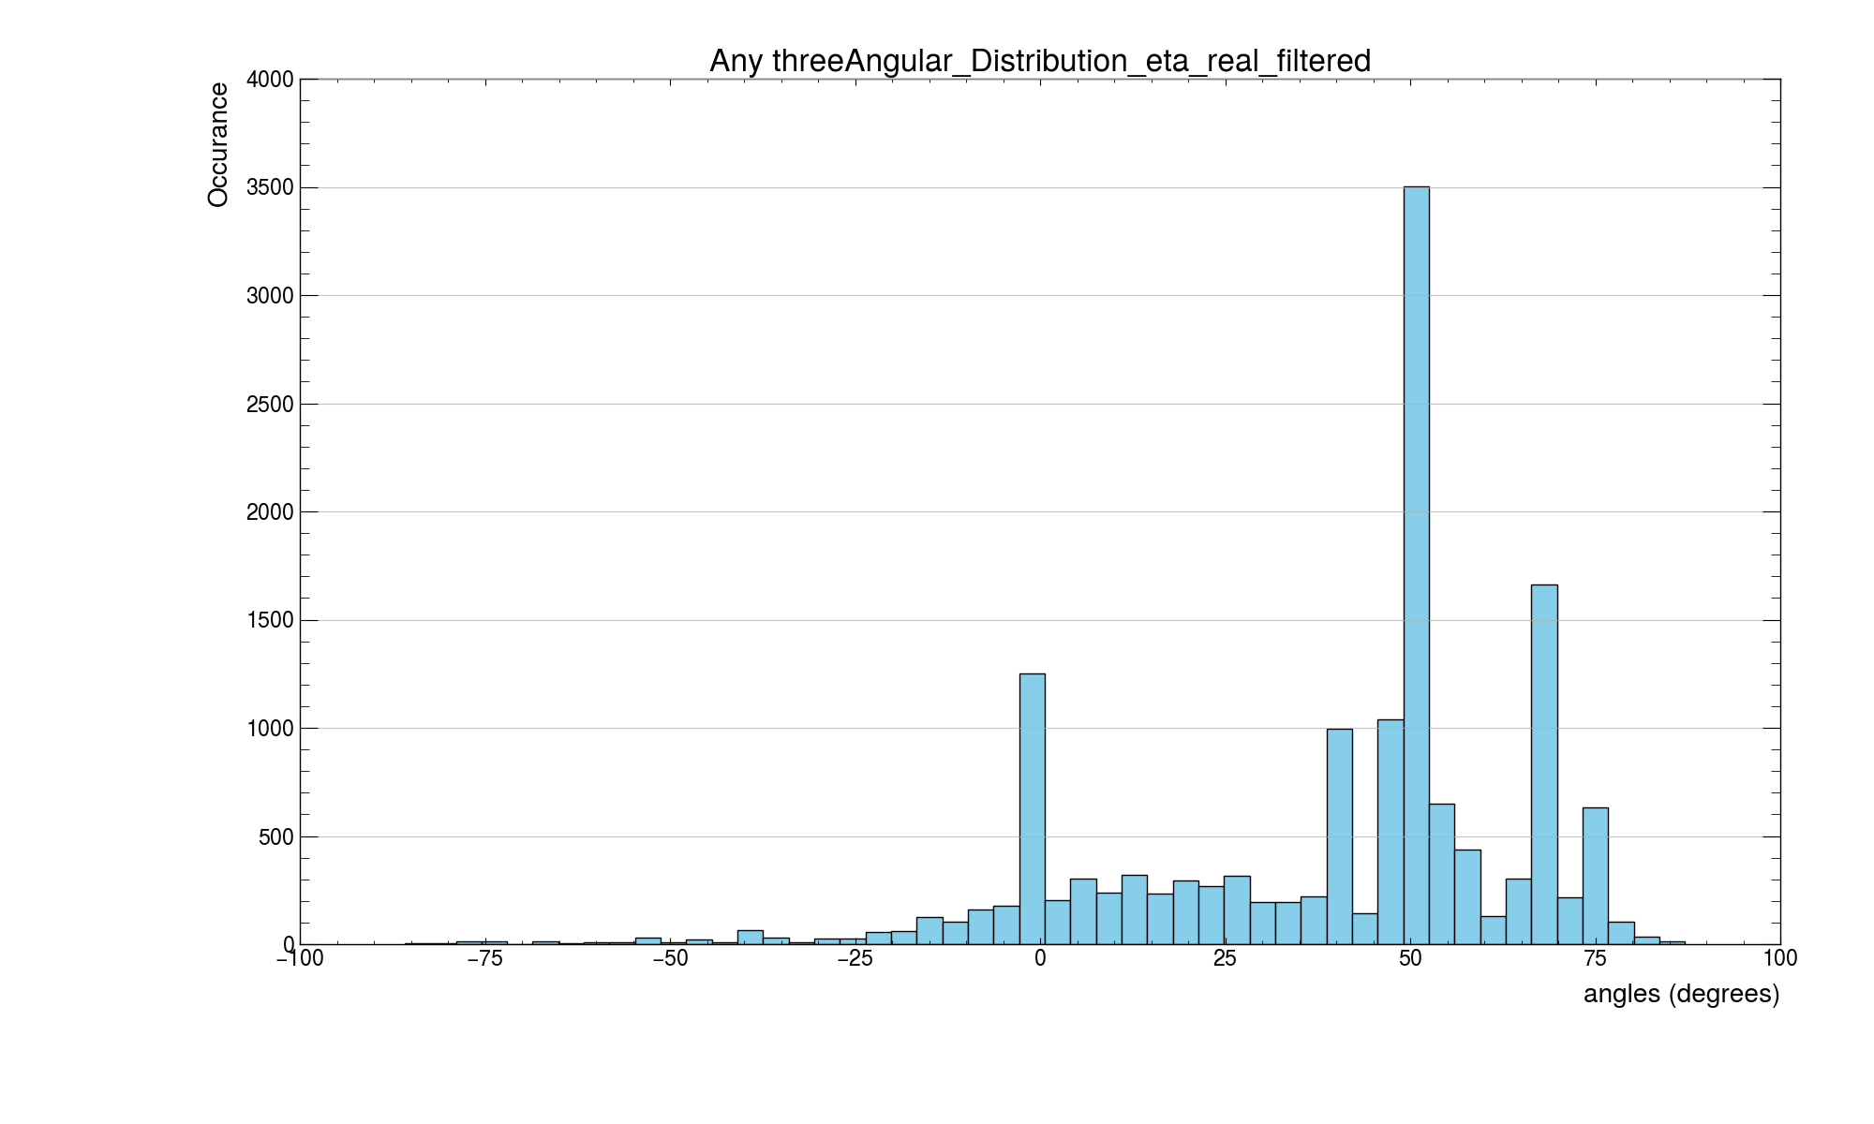

Slide 7
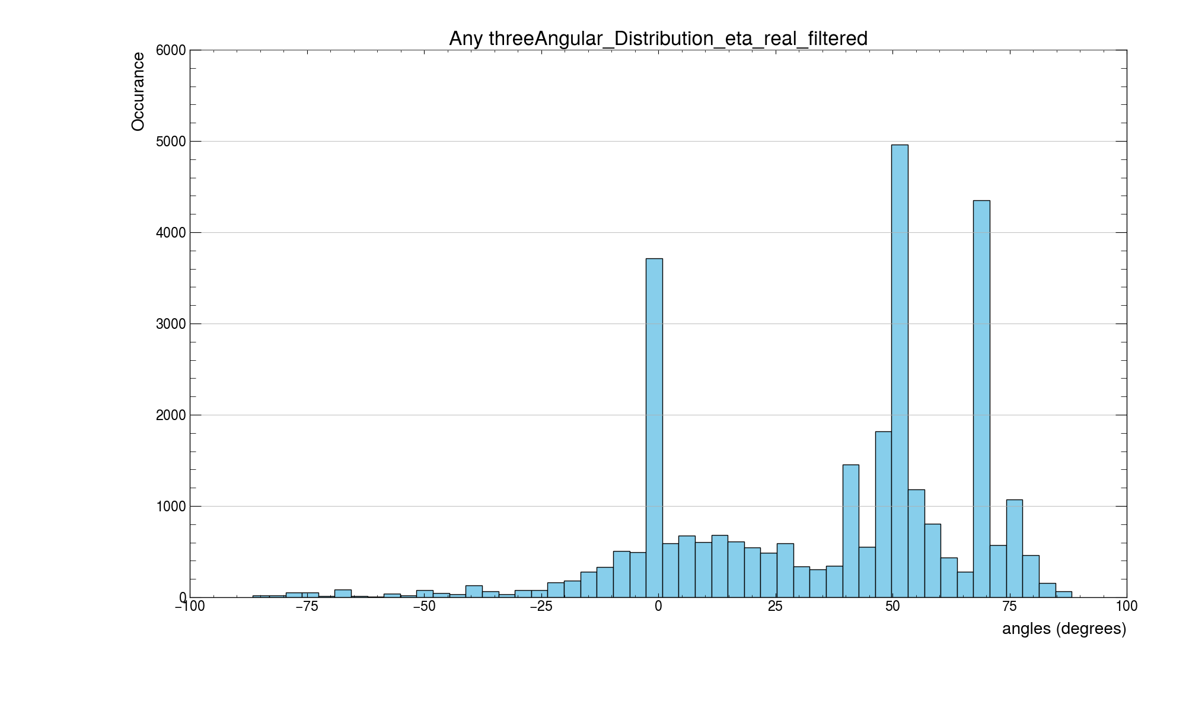

Slide 8
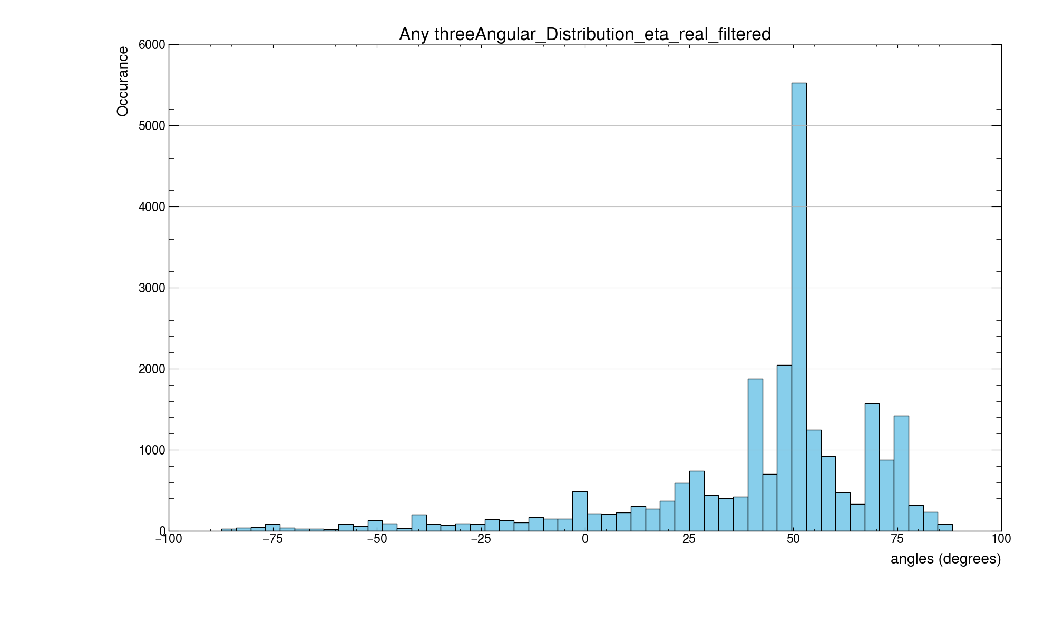

Slide 9
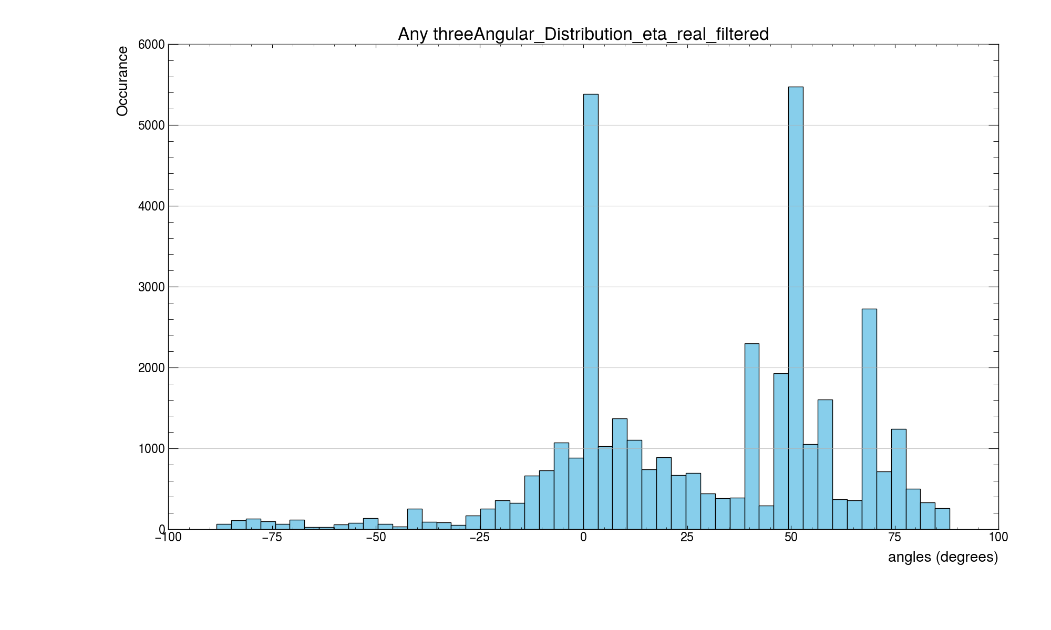

Slide 10
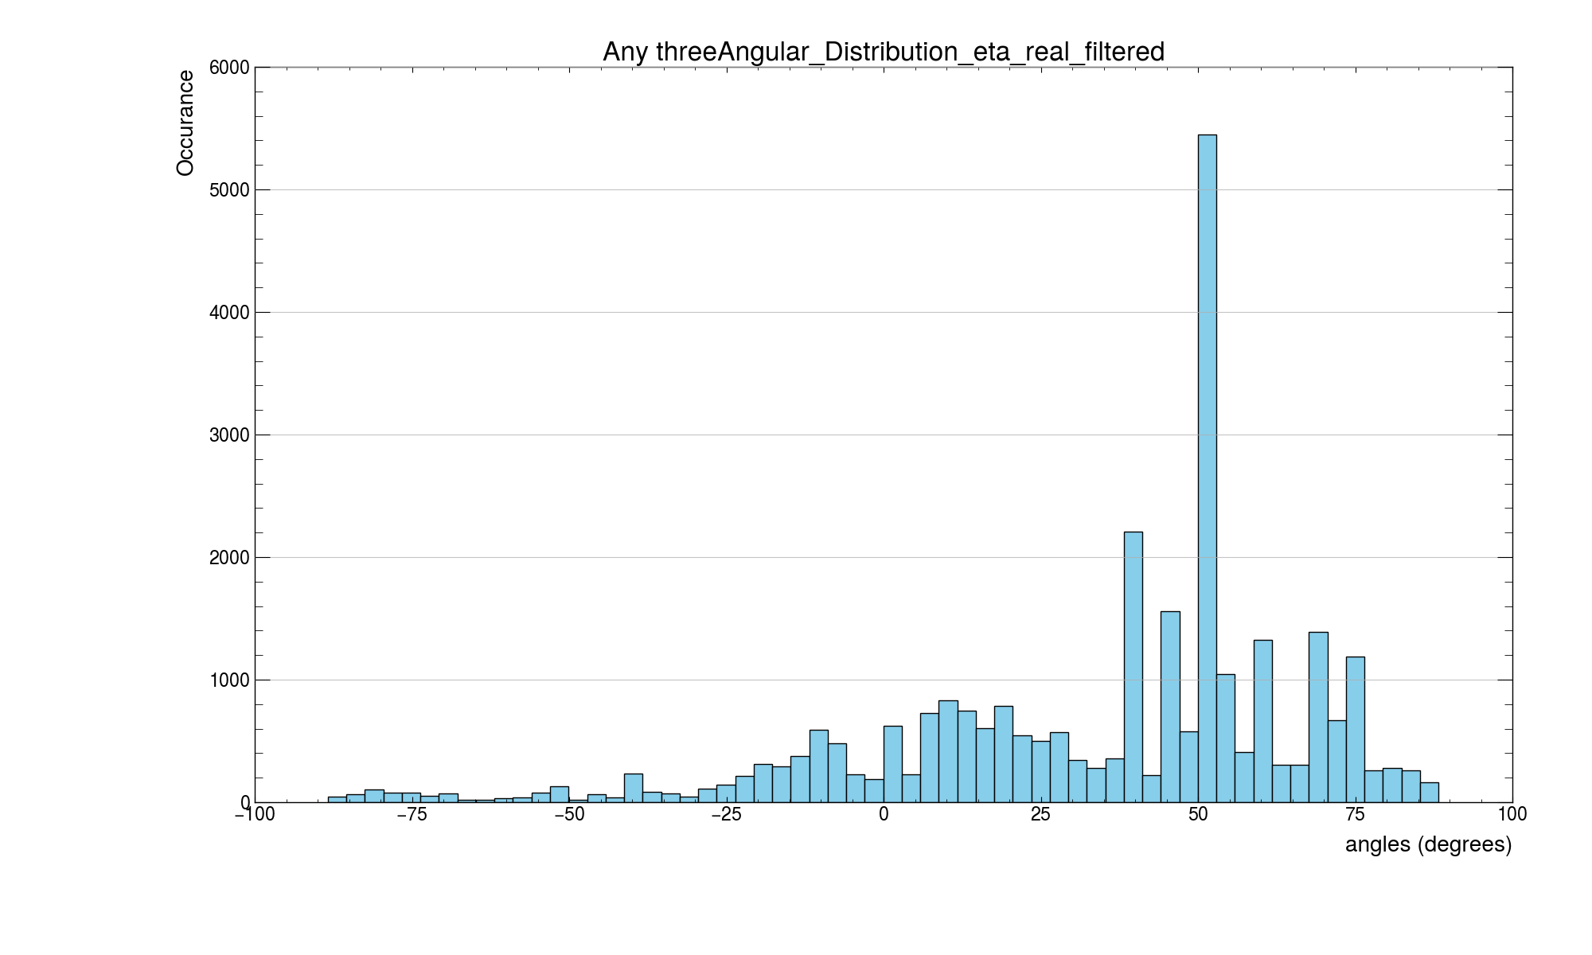

Slide 11
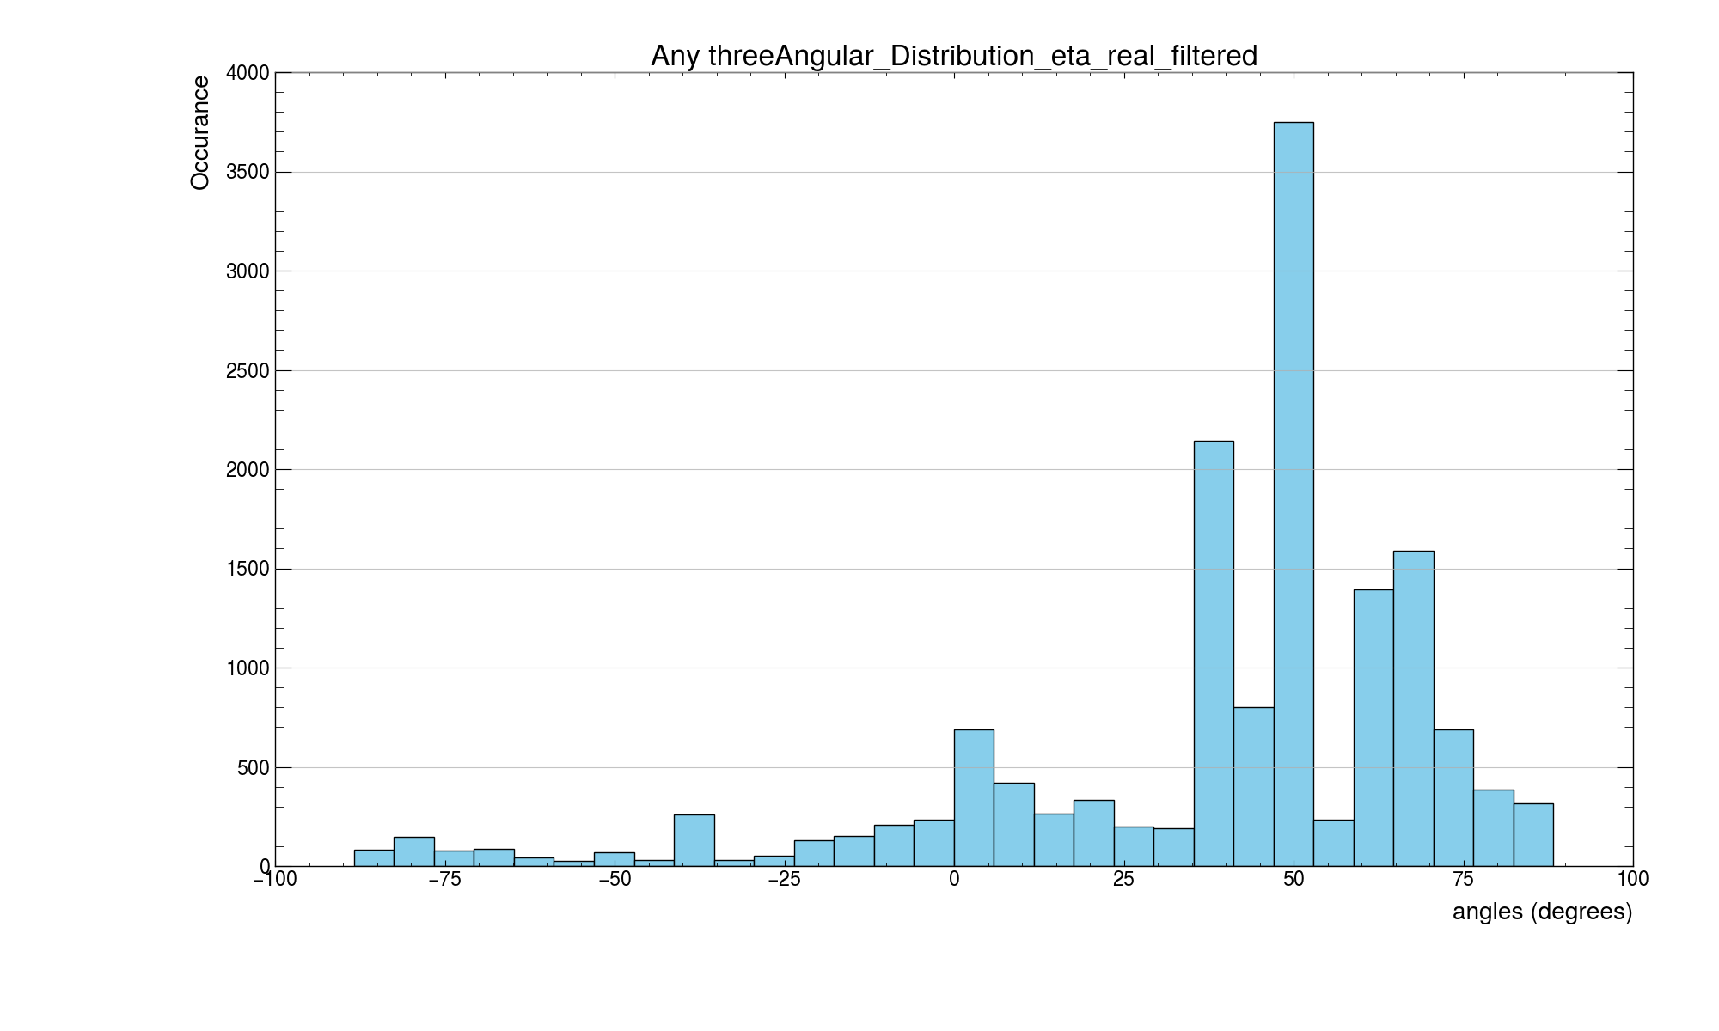

Slide 12
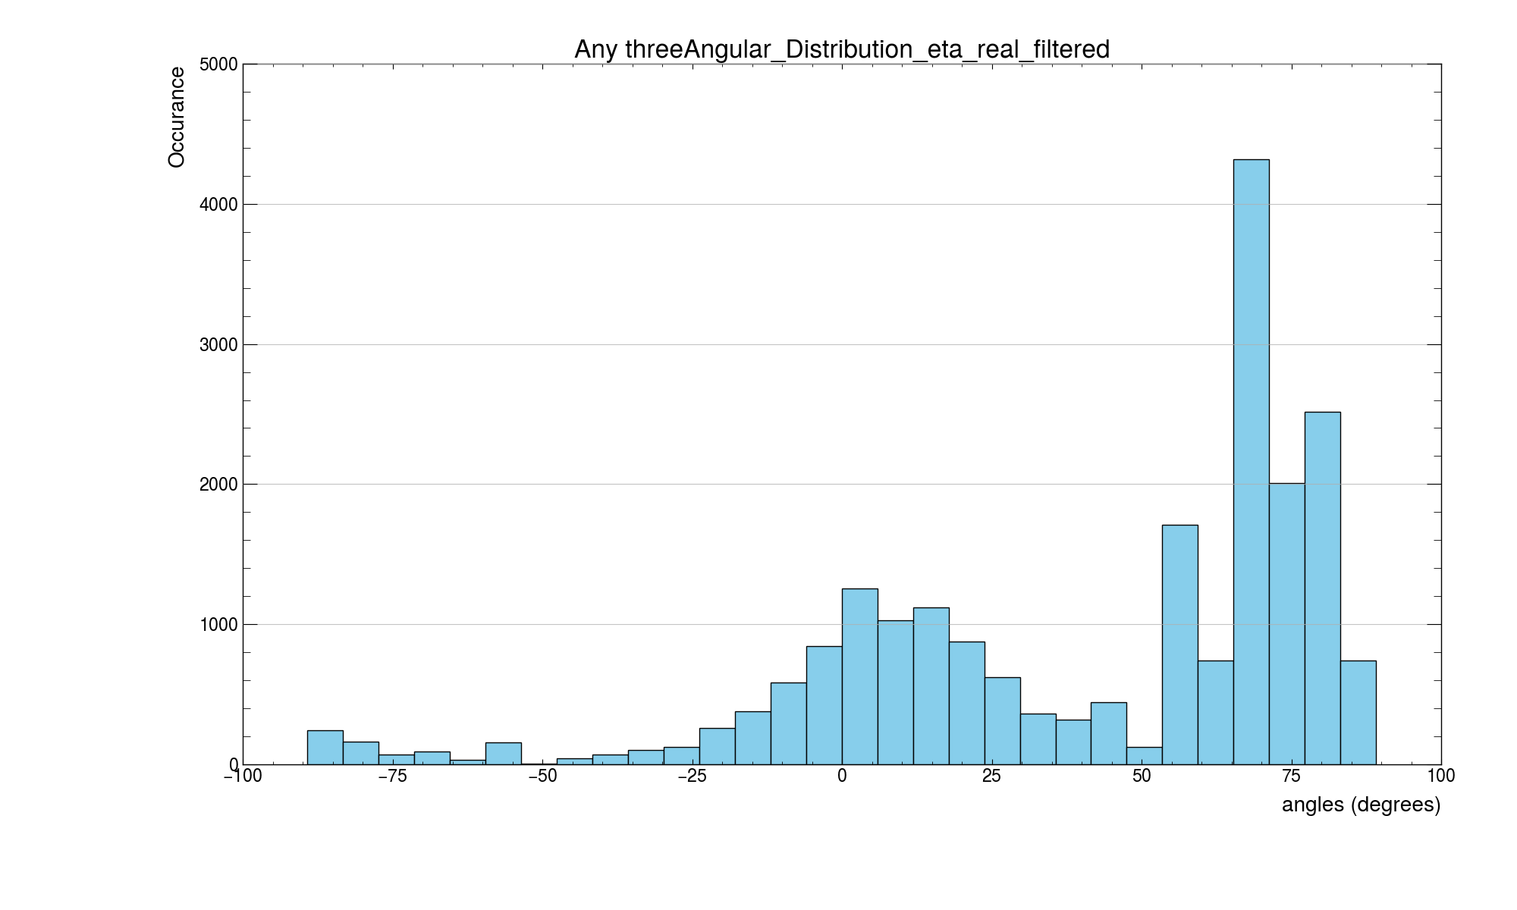

Slide 13
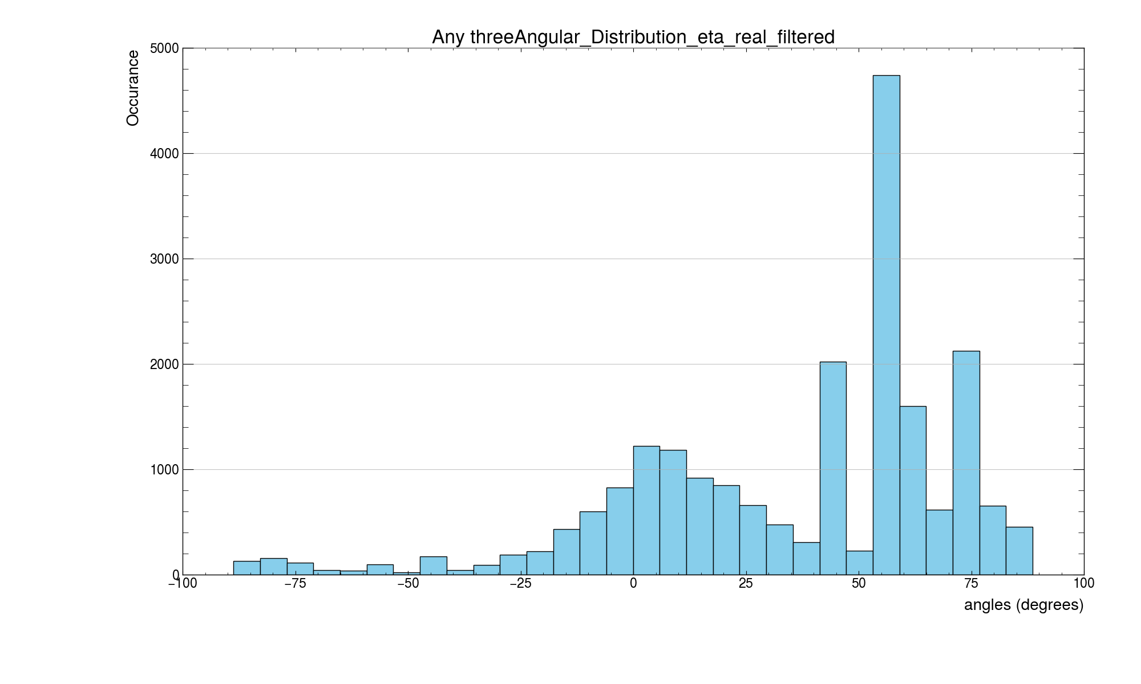

Slide 14
The simulation might miss factors floating around
½ Gev – 250 Gev muon energy
Detector resolution 0.5ns
TDC have 0.5 ns as well, total should be 1 ns
Use the earliest cluster time for clusters
Plot of cluster size 1 in each singlet.
Also use the strip closest to the paths.
Contraint even further.
Time walk on the FEB, and using a linear model from distance to the TDC
When doing delta T within triplet, stay within the same front end board, using the same front end board of 8.
Using the position, and the number of strip for reconnstructio this can easily be corrected by the time walk correction.

